Slide 1
Determining the Relationship Between Time, Transmission and the Evolution of the Rabies Virus
Rowan Durrant
Supervisors: Katie Hampson & Christina Cobbold

Slide 2
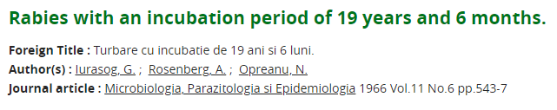
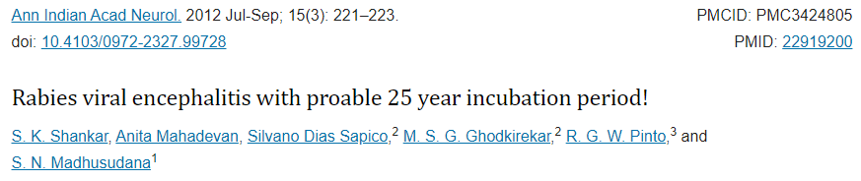
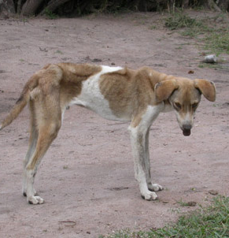
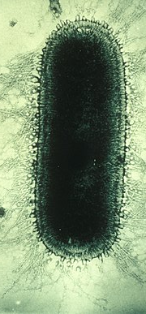
Intro to the rabies virus (RABV)
RNA virus
~ 12 kb
Mean serial interval of ~26 days, but can lie dormant for months or years in some cases
Stays in muscle fibres at the bite site during latent period- either no or very limited viral replication during this time
Then travels into neurons, spreads to CNS and causes death
Norden, a Smith-Kline Company - https://wildlife-damage-management.extension.org/disease-rabies/
Notes:
A lot of you will be familiar with rabies, but for those that aren’t, it’s an RNA virus of around 12 kilobases in size. Generally an animal bitten by a rabid animal will become infectious about 26 days later, but rabies can lie dormant in a host for months or years. The rabies virus tends to stay at the infection site for a while, not really doing anything, until it makes its way into the neurons and CNS where it eventually causes symptoms and death.

Slide 3
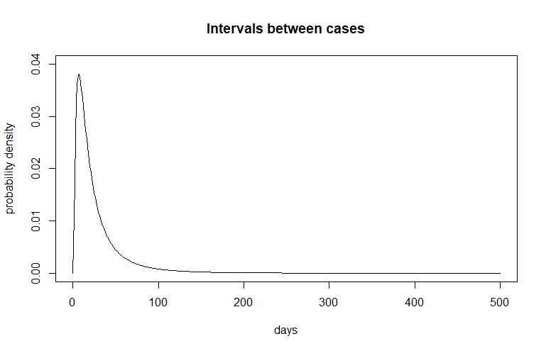
Incubation period
Symptomatic period
Case 1
Case 2
Case 3
Case 4
Serial interval
Case 5
Time
Notes:
So the time that rabies spends in its host can be broadly split into two periods: the time that it’s just chilling in the muscle tissue and moving along the neurons, which we’ll call the incubation period represented in blue, and the time where the virus has undergone massive replication in the brain and is causing symptoms where the host becomes infectious, represented in red.
and to give a bit of explanation to the term serial interval, this is the time between a host becoming infected and then infecting the next host along the chain- so as illustrated here, the period between case 2 being infectied and case 3 being infected. Because of the massive variability in the incubation period as discussed, the serial interval has a distribution with a very long tail, as we can see here.

Slide 4
My hypothesis
If RABV isn’t really replicating in the muscle tissue, it probably isn’t mutating
And if it isn’t mutating for months/years in some cases, is the clock rate really the best way to measure mutation rate?
The molecular clock model assumes that mutations accumulate linearly and consistently with time
Would it be better to measure mutation per serial interval (transmission generation)?
Notes:
So that got me thinking a bit about what’s happening with mutation while rabies is hanging out in the host’s muscle tissue for potentially months. If it’s not replicating, it’s not likely to be mutating as much as usual, and if it isn’t mutating for long periods of time, that could have implications on whether the molecular clock model applies to rabies – remember that a fundamental assumption of the molecular clock is that mutations accumulate consistently over time. If the molecular clock doesn’t apply, is the clock rate the best way to measure rabies evolution? Is there a better unit we can use?

Slide 5
Can we test this without lab methods?
Look at genetic divergence over time from rabies phylogenies
Simulate what these plots would look like if rabies mutates per generation or per unit time
Compare
Notes:
So my plan to test whether rabies mutation was more clock like or more per-generation based was to look at divergence plots for rabies outbreaks, and compare them to divergence plots from simulated outbreaks, where mutation happened either per unit time or per transmission. Another idea I had to look at this was to look at closely related rabies sequences, mother-daughter pairs or sibling pairs, and see if the genetic distance between them was significantly higher in child cases with long incubation periods, but unfortunately I haven’t found enough of these pairs in the contact tracing data to do this analysis.

Slide 6
Simulations
Per- unit time model
= SNP occurs
Case 1
Case 2
Case 3
Case 4
Time
Per- generation model
= sequence sampled
Time
Notes:
Here’s broadly how the simulations work: we take the output of a branching process simulation that Elaine Ferguson developed, and simulate genetic data on top of it in one of two ways: either per unit time, the top one, where the number of SNPs that case accumulates is based on the length of it’s serial interval, so SNPs should accumulate fairly consistently with time. And the per generation model, where the length of the serial interval doesn’t matter, and the number of SNPs a case gets is just based on a given mutation rate (with some stochasticity thrown in to both). We generate mutations down these transmission chains, then sample a proportion of the cases, and use those sequences to make divergence plots.

Slide 7
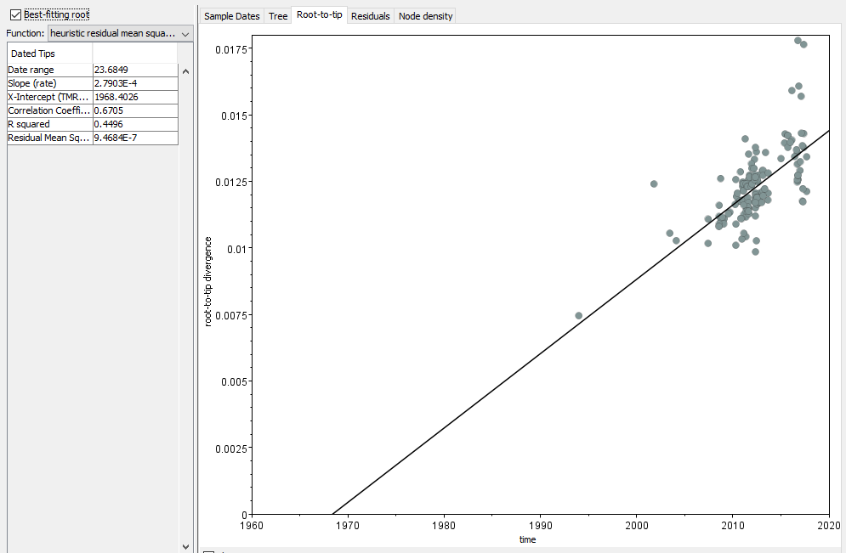
Genetic divergence increases over time, with distance from their common ancestor
Notes:
This is an example of a divergence plot for those who haven’t seen one before, the y axis is the proportion of bases in a sequence that have changed since the predicted common ancestor between all the sequences, and the x axis is time. These plots can be used to predict when the common ancestor happened, in this case around 1968. There are also some stats up in the top left corner, and I’m going to look a bit more into the R squared value for this analysis.

Slide 8
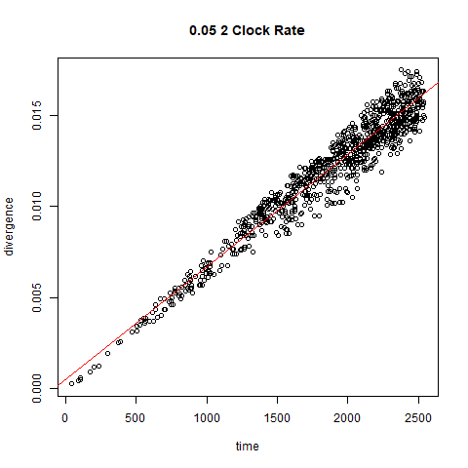
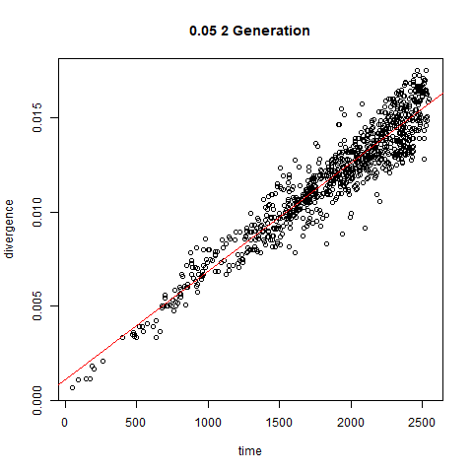
Simulated divergence differs depending on the mutation model
(5% of simulated outbreak sampled, equivalent to 2 mutations per generation)
Notes:
When looking at the divergence plots themselves, there are some features that differ between the two mutation models. When mutation followed the per-generation model, we get these little offshoots that are probably caused by particularly long or short serial intervals.

Slide 9
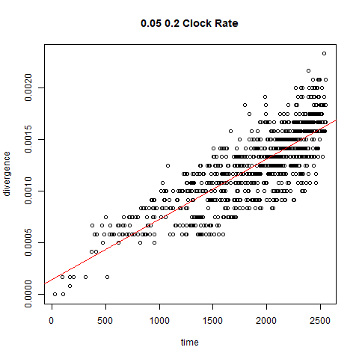
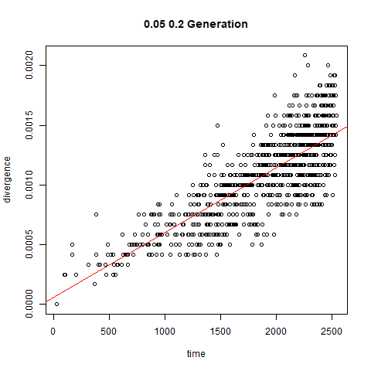
… but difference not discernible for simulated viruses with slower mutation rates
(5% of simulated outbreak sampled, equivalent to 0.2 mutations per generation)
Notes:
However, these patterns are much harder to see in simulations with a lower mutation rate, which is problematic seeing as we know the rabies virus has a fairly low clock rate compared to other RNA viruses.

Slide 10
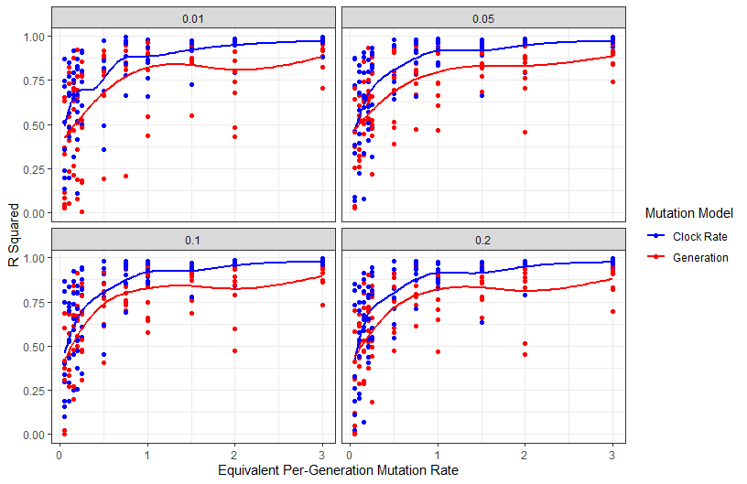
Slight difference in R^2 values between mutation models at higher mutation rates
Notes:
So I compared the R squared value of divergence plots from simulated outbreaks across different levels of case sampling and mutation rates (which have been converted to a per-generation rate for ease of comparison). As we can see sampling rate doesn’t make much difference, but at higher mutation rates there is a much clearer divide between the two mutation models than for rates below about 0.5 SNPs/generation.

Slide 11
Weird. So what’s RABV’s mutation rate?
The clock rate is very low compared to other RNA viruses, so there might not be a perceivable difference between the two mutation models
We can calculate the mutation rate on a per-generation basis anyway though, because it’s a useful number to have
We tested two methods:
The method I developed, which takes temporal and genetic distances between sequences from a time-scaled phylogeny
A simpler method, where the clock rate is multiplied by the genome length and the mean SI or SI distribution
Notes:
Based on that it might be useful to find out what rabies’ per-generation mutation rate is, and also just because it’s a useful value to have for calculating how closely related cases are etc. So we compared two methods of doing this- a novel method that involves taking pairwise genetic and temporal distances between cases based on a time scaled phylogenetic tree, and a very simple method of multiplying the clock rate by the serial interval distribution and the genome length.

Slide 12
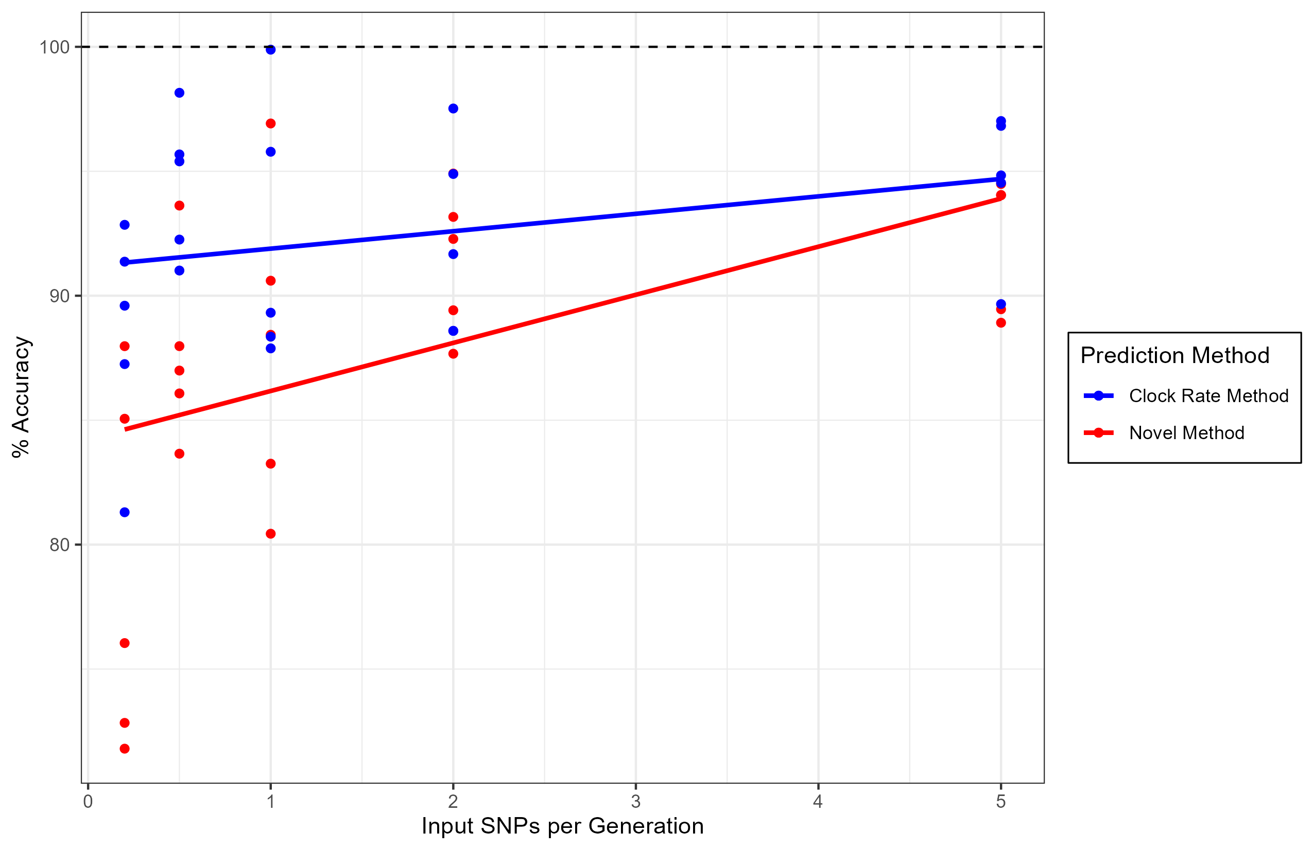
Which method works best?
Notes:
We compared the two methods using simulated outbreaks with different input mutation rates using the per-generation mutation model. Accuracy increased as mutation rate increased, and while the simpler clock rate method of mutation rate prediction did better, both methods did reasonably well at predicting the input mutation rate.

Slide 13
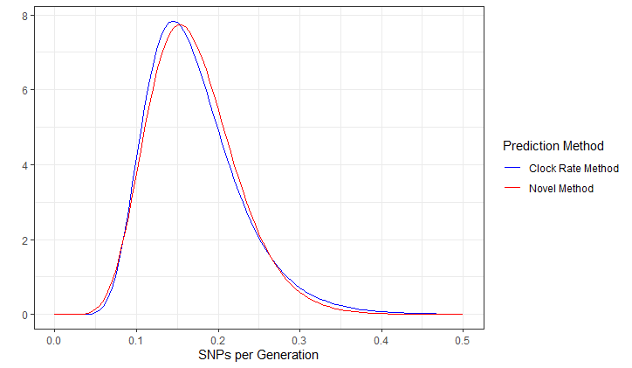
Both methods predicted RABV’s mean mutation rate to be ~ 0.17 SNPs/generation
Notes:
We applied both methods to a set of rabies sequences from Tanzania, and they came out pretty close, and both gave a mean value of 0.17 SNPs / generation – which is super low. This suggests to me that since no SNPs are expected to happen on most generations anyway, it probably doesn’t practically matter whether they’re happening per unit time or per generation.

Slide 14
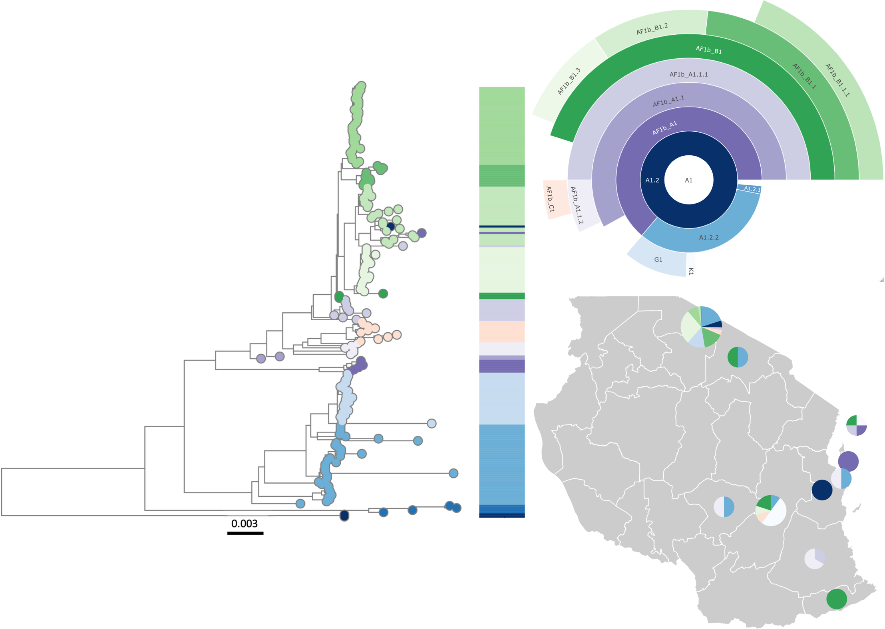
There can be multiple co-circulating lineages of rabies at any given time
Campbell et al. 2022 – PLOS Pathogens

Slide 15
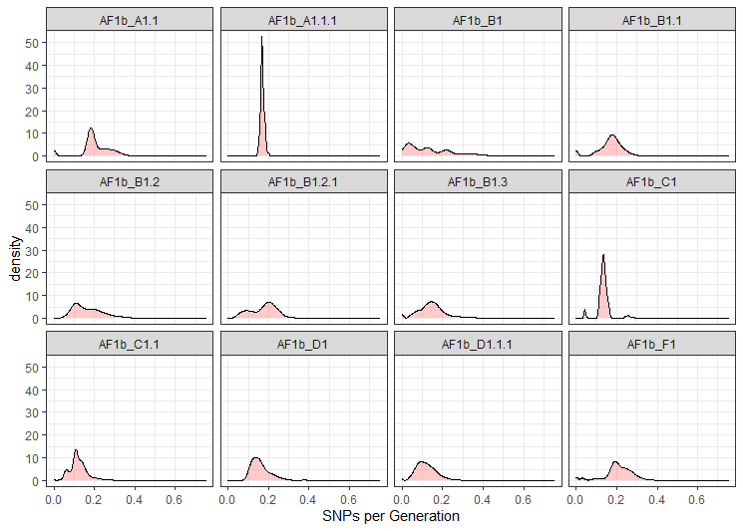

Cool lineage stuff
Different lineages have different mutation rates
Working with Kat Campbell to figure out why some lineages have a really low mutation rate – biological or epidemiological?
Lowest mean: 0.12 SNPs/gen
Highest mean: 0.21 SNPs/gen
Notes:
I also had a look at whether differences in mutation rate existed between rabies lineages, and there’s a fair amount of variation. I’m now working on a paper with Kat Campbell on the demographic differences between rabies lineages, including mutation rates, where we’re getting some cool results and having some fun discussions on whether the cause of the mutation rate variation we’re seeing is biological or epidemiological. We’re planning on presenting this to the evolutionary analysis group at some point so keep an eye out for that if you’re interested.

Slide 16
What does all this mean?
It may not matter in the long run how we measure RABV mutation due to its low mutation rate – it’s probably not mutating over most generations
The questions proposed in my hypothesis may still be interesting to consider for high-mutating viruses with long latent periods
Nonetheless, per-generation mutation rate estimations are useful to have – for example, for outbreak size estimation from genetic diversity, which can be used to evaluate case detection
Notes:
My main takeaways from this project so far is that while the mutation model of rabies in particular doesn’t make much of a practical difference, due to rabies’ super low mutation rate. Over the course of many generations the cases with unusually high serial intervals will just kinda average out with the shorter infections, and not really make too much of a difference.
This may however be something to think about for viruses that have both long latent periods and a higher mutation rate.
Final thing- complex methods that take ages to run aren’t necessarily going to give you better results than some quick calculator math.

Slide 17
What am I doing next?
Viral Genomics & Evolution Conference – 9th-11th November
Wrapping up this chapter into something hopefully publishable
Lineage emergence rates- can we figure out how many lineages we’re meant to see at certain outbreak stages & sizes?
Outbreak size prediction based on observed genetic diversity
Notes:
My plans for the future look a bit like this- VGE next month presenting a poster on this work, then wrapping this up and moving on to some more lineage stuff- I’m planning a project on predicting how many lineages should be observed at different stages and sizes of rabies outbreaks, and maybe looking into whether we can then use that to infer what’s going on with the outbreak. Also thinking of having a look at whether we can predict outbreak size based on genetic diversity.

